Slide 1
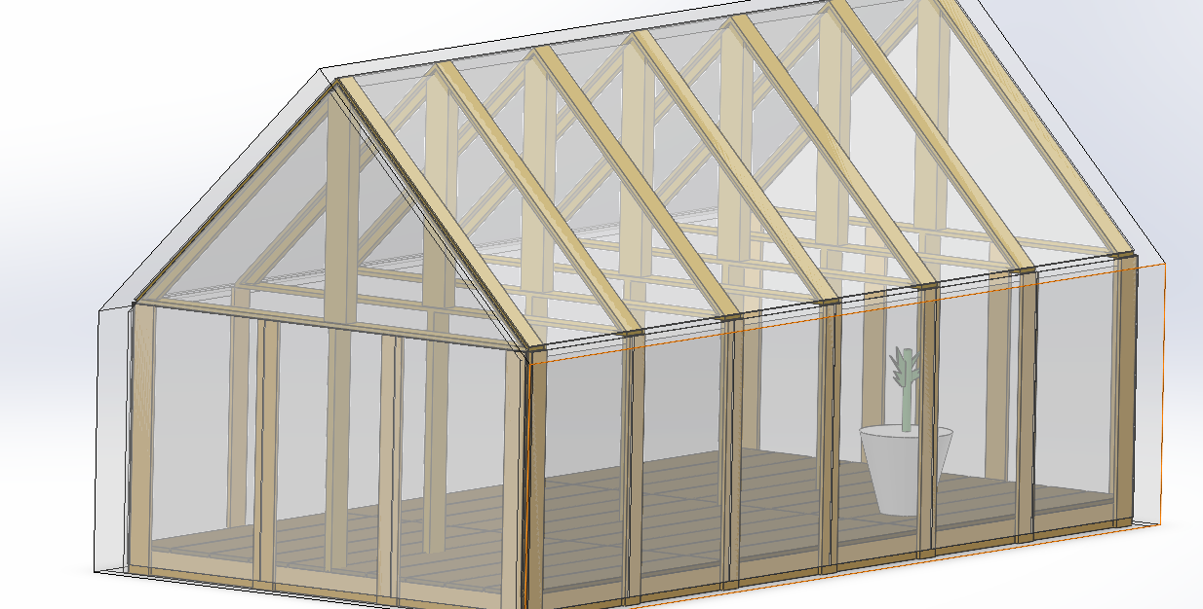
Cabin Shaped Greenhouse
Introduction & Heat Transfer Analysis
Chief Mechanical Engineer Mingxuan Yang, 260832163
Chief Structural Engineering Zongxuan Lin, 260780979

Slide 2
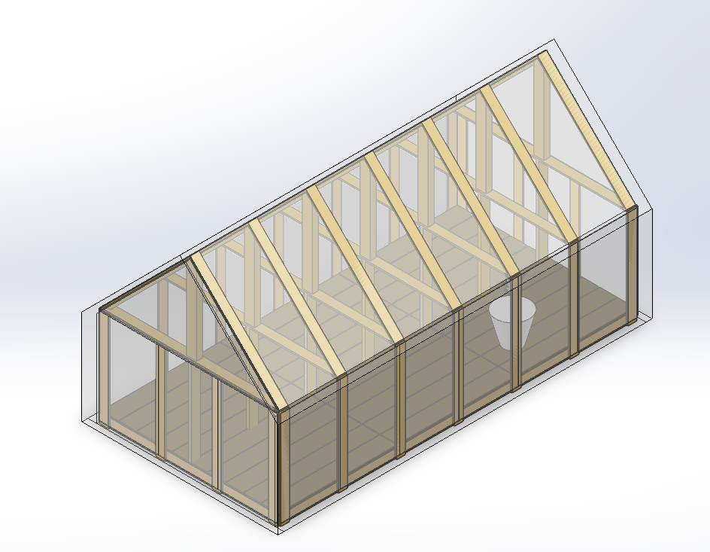
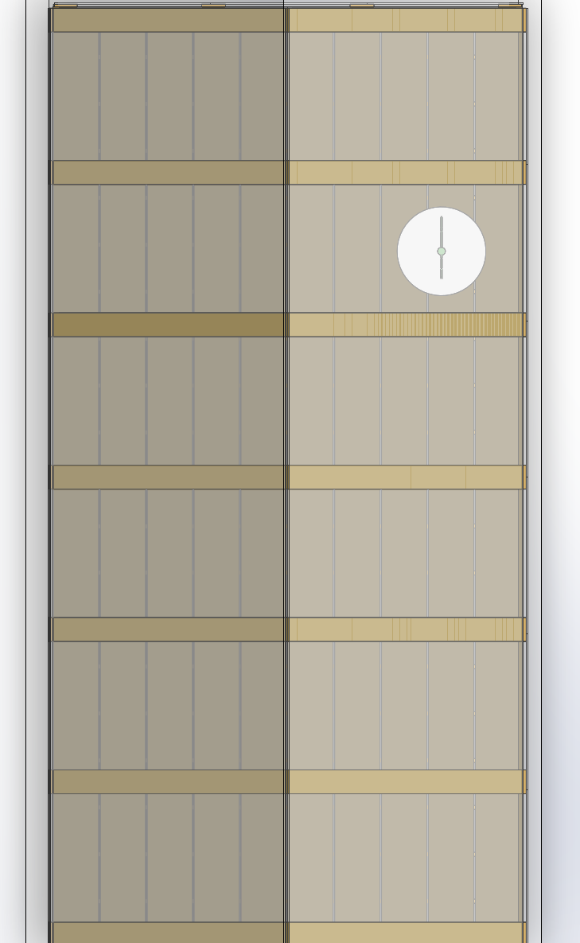
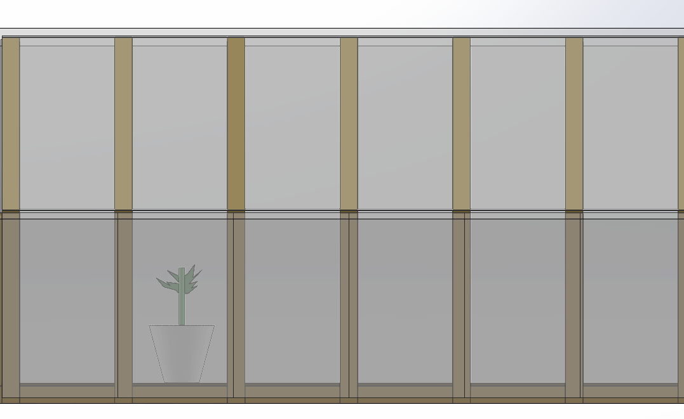
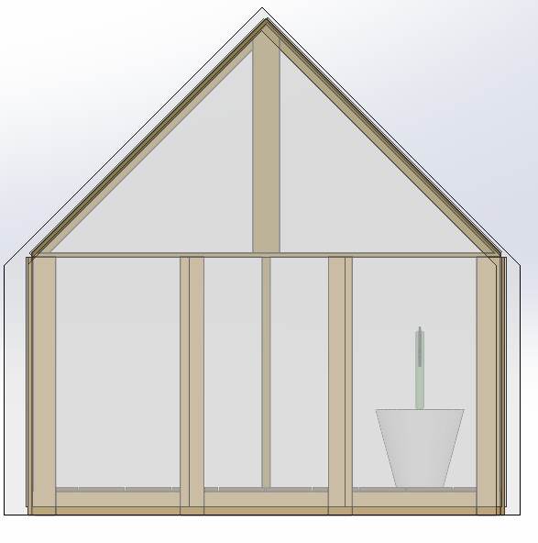
Specifications
Height:3m(Excluding base),3.1524m(Base included)
Roof Tilt Angle:45 degrees
Wall Height:1.5m
Width:3m
Length6m
Material: Oak wood for support and flooring
Wall：10mm thick poly carbonate twin wall panels
Supplementary Insulation material: 6mil polyethylene films
6m
3m
1.5m

Slide 3
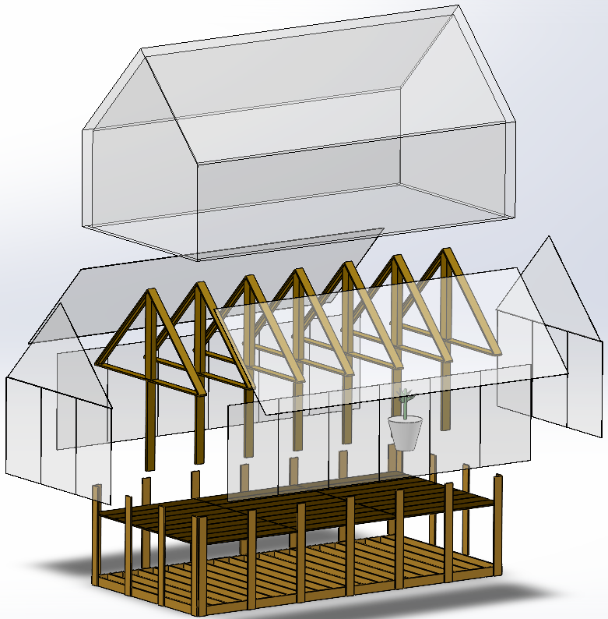
Montreal Winter Combo Highlights
PE films
Wind speed 16m/s
Dry bulb Air temperature:-20c
Average Solar radiation :300W/m^2
Day time length:6hours
112m^2 of high efficiency solar panels to store energy for nighttime heating
3 tesla power wall 2 to store energy (or equivalent)
8 sheet of polyethylene films applied during the day
20 sheets of polyethylene films during the night. Films will be knitted together.(8 layer*1, 4layer*2,2layer*2,&single layer *1)
PC panels

Slide 4
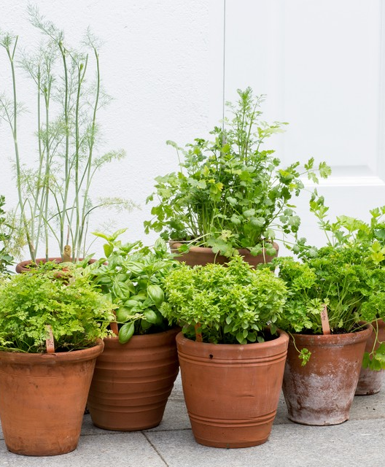
What can Our Design do?
It keeps average internal temperature of above 16 Celsius. Our clients can grow a variety of plants: tomatoes, basil, coriander, most of flowers, and many other fruits and vegetables.
No need for extra heating during the day, 36kwh of energy consumed during night.
Guarantee survival of Montrealer’s plants even in the worst time of the year.
Clients can adjust number of PE films to adapt to varying weather conditions.

Slide 5

Enjoy gardening with our Greenhouse!

